Slide 1
Technical Communication
Introduction to ENGR 120
Brief Overview of CH. 1 and 2

Slide 2
Why this course?
Poorly written resumes and cover letters are likely to doom a candidate’s chances of getting an interview
Writing remediation (fixing problems caused by poor writing) costs businesses in the U.S. almost $4 billion annually – possible up to $400 Billion in lost productivity! [1]
50% of private employers and 60% of state government employers say writing skills impact promotion decisions
Engineering accreditation board requires COMMUNICATION skills to be an integral part of an ENGR program – as one of the 12 Graduate Attributes

Slide 3
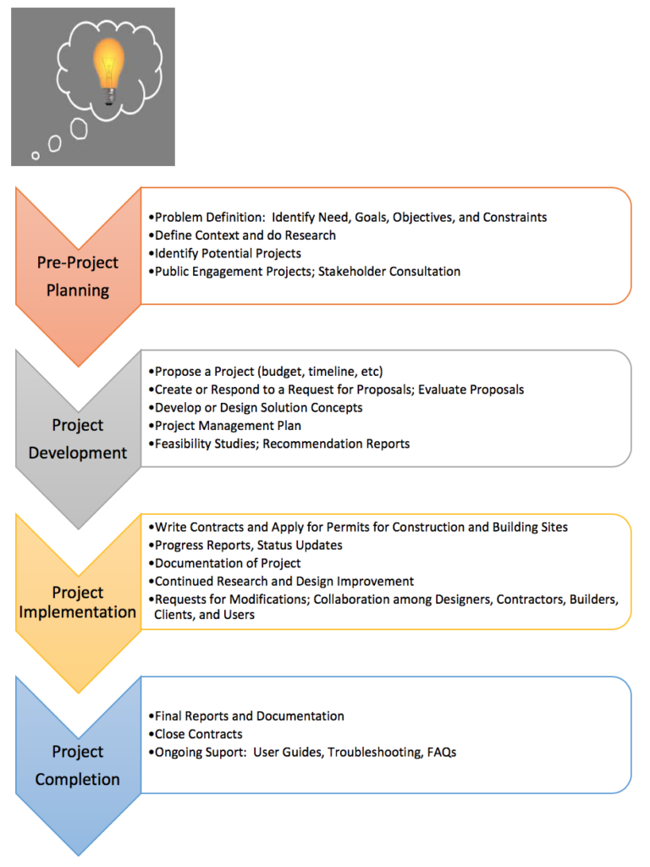
Success in a professional field requires communication skills
Every project requires communications tasks to get it started, conduct it, and complete it.
Every job ad you see will ask for two competencies:
Excellent communication skills
Ability to work as part of a team

Slide 4
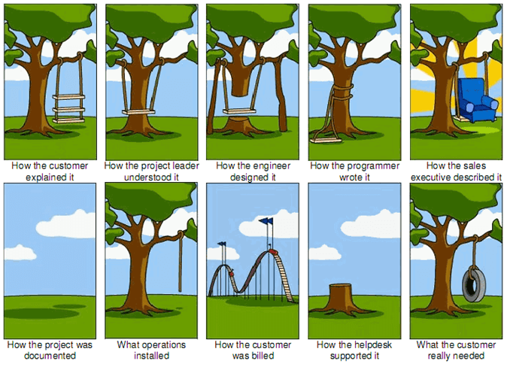
Project Management Cartoon [2] illustrates the perils of poor communication

Slide 5
In a Professional Context
How Graduate Engineers spend their time:
25-50% problem solving of some kind
50-75% communicating (writing and reading reports, letter, emails, memos, proposals; discussions/meetings/presentations with colleagues, managers, clients, government, and the public [3]
Job performance evaluations and advancement depend more on communication skills than technical skills
70% of engineers and almost 50% of programmers rated the quality of their writing as either “very important” or “extremely important” to the performance of the their jobs [4]

Slide 6
Getting a job, doing it well, and being promoted are largely dependent on your ability to communicate effectively and professionally in a workplace context

Slide 7
What is technical Communication?
The communication of specialized technical information – written, oral, or visual – that has specific and practical purposes and is usually designed for a particular audience. General purposes include
Informing (progress reports or status updates; documentation)
Instructing (instructions)
Persuading (proposals)
TRANSACTIONAL communication -- designed to fulfill a purpose (solve a problem)
READABLE – emphasis on document design for readability (user-friendly design)
Notes:
Can range from technical manuals to yoga instructions

Slide 8
Academic vs technical writing
 | Writing for School | Writing for Work
Purpose
Audience
Content/Message
Document lifespan
Legal Liability
Format/Design
Style

Slide 9
Key principles
Generally, in a technical workplace, NO ONE REALLY WANTS TO READ WHAT YOU HAVE WRITTEN! But they have to because it’s part of their job.
Make your reader’s job as easy as possible by making your writing
Direct and concise – make the PURPOSE clear immediately; avoid fluff
Courteous and constructive – focus on solutions
Well formatted – Design documents for selective reading
Reader-centered – Provide information the reader needs to complete their task
Before you begin writing, determine your purpose and audience.

Slide 10
Purpose
Determine your purpose in both a general sense (goal) and a specific one (objectives):
What problem are you trying to solve by communicating?
What do you want your reader to do or think as a result of reading your document?
General purposes:
Inform or instruct
Create a record (lab report, procedures followed, documentation)
Request or Provide information (background report, instructions, etc)
Persuade (proposal, recommendation report, etc)

Slide 11
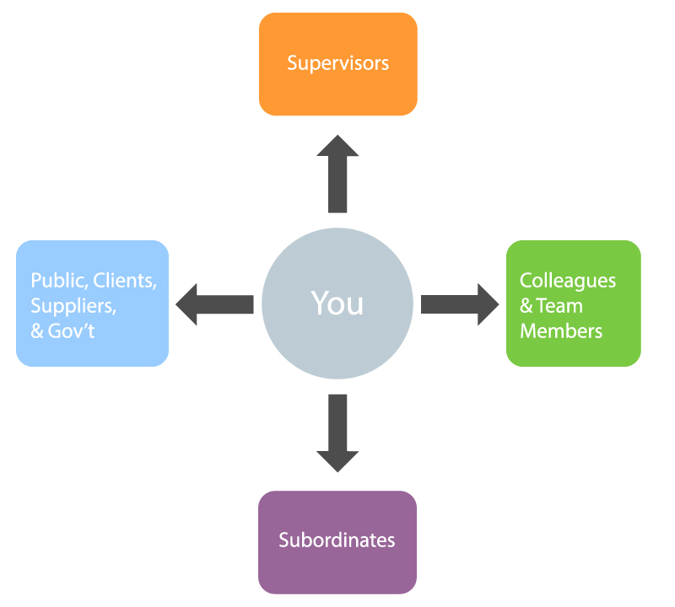
Audience
Workplace writing is meant to be read by someone with whom the writer has a professional relationship
Boss, supervisor
Clients, prospective clients, colleagues
Contractors, manufacturers, builders, technical workers, potential donors or stakeholders
Subordinates
Determine WHO you are writing to, why they might read this, and what information they need.

Slide 12
Audience and Purpose
Type of Audience | Purpose for Reading
Executives | To make decisions and be informed
Supervisors (experts) | Advise the decision makers
Technical experts | Implement decisions and advice supervisors
Lay person (non-expert; general public, clients, etc.) | Become informed; choose options, vote, donate, volunteer, etc.

Slide 13
Reader-centered approach
Being “reader-centered” means understanding who your audience is, what they need, and anticipating their potential questions:
What do I need to know?
What am I expected to do?
What is this document? Why do I need to read it?
How does this affect or relate to ME? Is this my problem to solve? Do I need to make a decision?

Slide 14
Professional tone
Tone = attitude conveyed by the piece of writing towards the topic and/or the reader. Using the wrong tone can cause serious problems.
Tone is connected to the “emotional appeal”
Consider:
a workplace is often hierarchical (implied power relationships)
an effective workplace requires cooperation and teamwork
How will your reader(s) feel as a result of reading this?
How do you want your reader(s) to feel?

Slide 15
constructive tone
Generally, professional writing seeks to maintain a positive and constructive tone:
Focus on being READER-centered rather than writer-centered.
Use positive phrasing instead of negative phrasing
Be respectful and constructive, even when giving bad news or criticism.
Focus on positive result or outcome; be solution-oriented
Be calm; be the “voice of reason”

Slide 16
Fundamentals
The key concepts in undertaking any workplace communications are
Understanding the PURPOSE (task analysis; problem definition)
Knowing your AUDIENCE and their needs
Using the appropriate TONE
Once you have done this, you can begin working on choosing the content, organization, and format for your document that will best suit your purpose and audience.

Slide 17
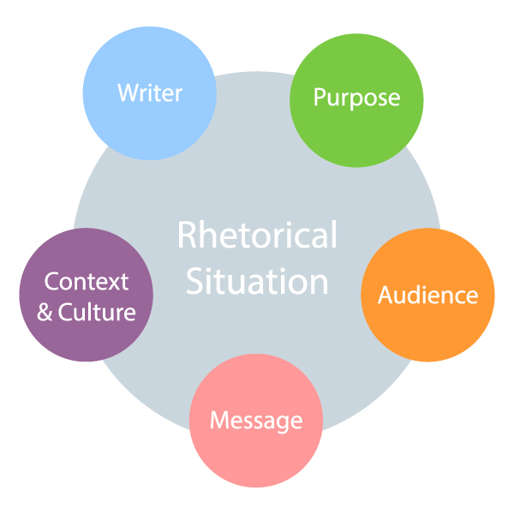

Slide 18
References
[1] J. Bernoff, "Bad writing costs business billions," Daily Beast, Oct. 16, 2016 [Online]. Available: https://www.thedailybeast.com/bad-writing-costs-businesses-billions?ref=scroll https://thinkgrowth.org/the-high-cost-of-poor-writing-about-400-billion-559e9fe5f735
[2] J. Ward, "The project management tree swing cartoon, past and present," TamingData, July 8, 2019 [Online] Available: https://www.tamingdata.com/2010/07/08/the-project-management-tree-swing-cartoon-past-and-present/
[3] S. McConkey, Co-op Coordinator, Presentation to first year engineering students 2017.
[4] J. Swartz, S. Pigg, J. Larsen, J. Helo Gonzalez, R. De Haas, and E. Wagner, "Communication in the workplace: What can NC State students expect?" Professional Writing Program, North Carolina State University, 2018 [Online]. Available: https://docs.google.com/document/d/1 pMpVbDRWIN6HssQQQ4MeQ6U-oB-sGUrtRswD7feuRB0/edit ↵

